Slide 1
Golang Project
“Crystal Caves” game server

Slide 2



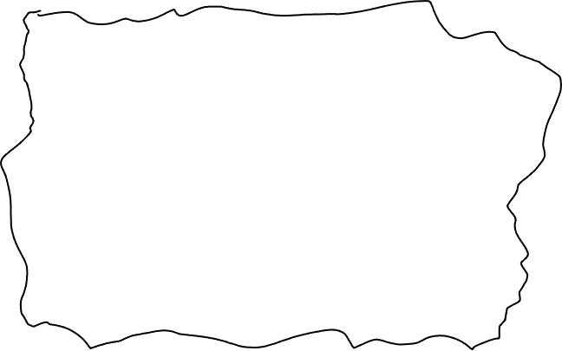
Game Design
SCOREBOARD:
Alice: 10
Bob: 8 Cathy: 11
Browser-based game
Player(s) move around room with arrow keys
Players collect crystals while avoiding monsters
Monsters move semi-randomly
Scoreboard updates with # crystals collected

Slide 3
Things I want to learn in Go
Networking – Websockets
Multiple processes & messaging
Database Storage (maybe)

Slide 4
System Architecture
Browser Clients
(Javascript)
Browser sends keystrokes as they happen
Game Server
(Golang)
Browser Clients
(Javascript)
WEBSOCKET
Server sends position of all entities N times per second
Browser Clients
(Javascript)

Slide 5
Server Architecture
One process for each websocket connection
One process for game state
Websocket process sends message to game state whenever a keystroke is received
Game state loops N times per second:
Updating position of all entities based on velocity
Check for collisions
Update score
Send array of positions & scores to each websocket

Slide 6
Server Architecture
Websocket Process
Main Loop
Game State Process
Keystrokes
Server sends position of all entities N times per second
Websocket Process
Update
Read
Websocket Process
State Objects (Arrays)
Crystals Enemies
Players

Slide 7
Entity Component Architecture
Player
• Controllable
• Moveable
• Collidable
Monster
• Moveable
• Collidable
Crystal
• Collidable

Slide 8
Entity Component Architecture
Player
• Has Position
• Controllable
• Moveable
• Collidable
Monster
• Has Position
• Randomizer
• Moveable
• Collidable
Crystal
• Has Position
• Collidable
Main Loop:
Use current keystrokes to update velocity of all controllables
Use randomness to alter velocity of all randomizers
Use velocity to update position of all moveables
Check for collision of all collidables with each other

Slide 9
Future Directions
Game lobby
Time limit
Difficulty levels
Persist high score history

